Slide 1


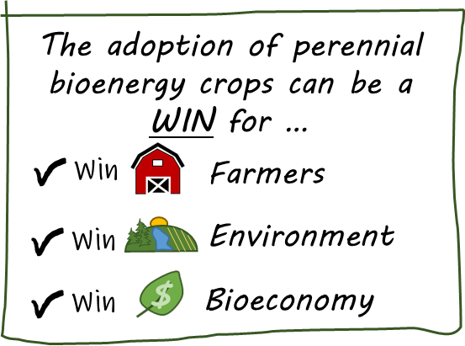

SUPERBEEST
Welcome to
superbeest.evs.anl.gov
Updated Oct 2023
Scaling Up PERennial Bioenergy Economics and Ecosystem Services Tool
SUPERBEEST is on online geospatial tool being developed to assist in decision making by various stakeholders regarding the adoption of perennial bioenergy crops on current row crop land (corn, soybean, pasture) in the U.S. Midwest
Goals
Provide farmers the opportunity to be valued stakeholders in the Bioeconomy and leverage marginal land to produce biomass & ecosystem services (ES)
Create resilient rural communities by offering diversified opportunities for entrepreneurships, jobs, & a clean environment
Help decarbonize community energy requirements
Intended Users: EVERYBODY (farmers, landowners, researchers, watershed managers, water quality regulators, biorefinery planners, etc.)
Identify Suitable Areas for Saturated Bioenergy Buffers
Ecosystem Services Realized from Crop Change
Economics Realized from Crop Change
Identify Marginal Land
Current
&
Future Capabilities
Economically or environmentally marginal
Reduced land-use change
Used for nutrient management in tile-drained land
Suitable acres based on specific criteria
Water quality
Carbon sequestration
Greenhouse gases
Hunting & recreation
Net economic value
ES value
Crop return
Change of inputs

Slide 2

Landing Page
Launch the tool
superbeest.evs.anl.gov/tool
Links to the SUPERBEEST Tool
Introduction for the tool
News on tool updates and website changes
Resources for download
Link to our research team’s work related to bioenergy crops
Contact information

Slide 3
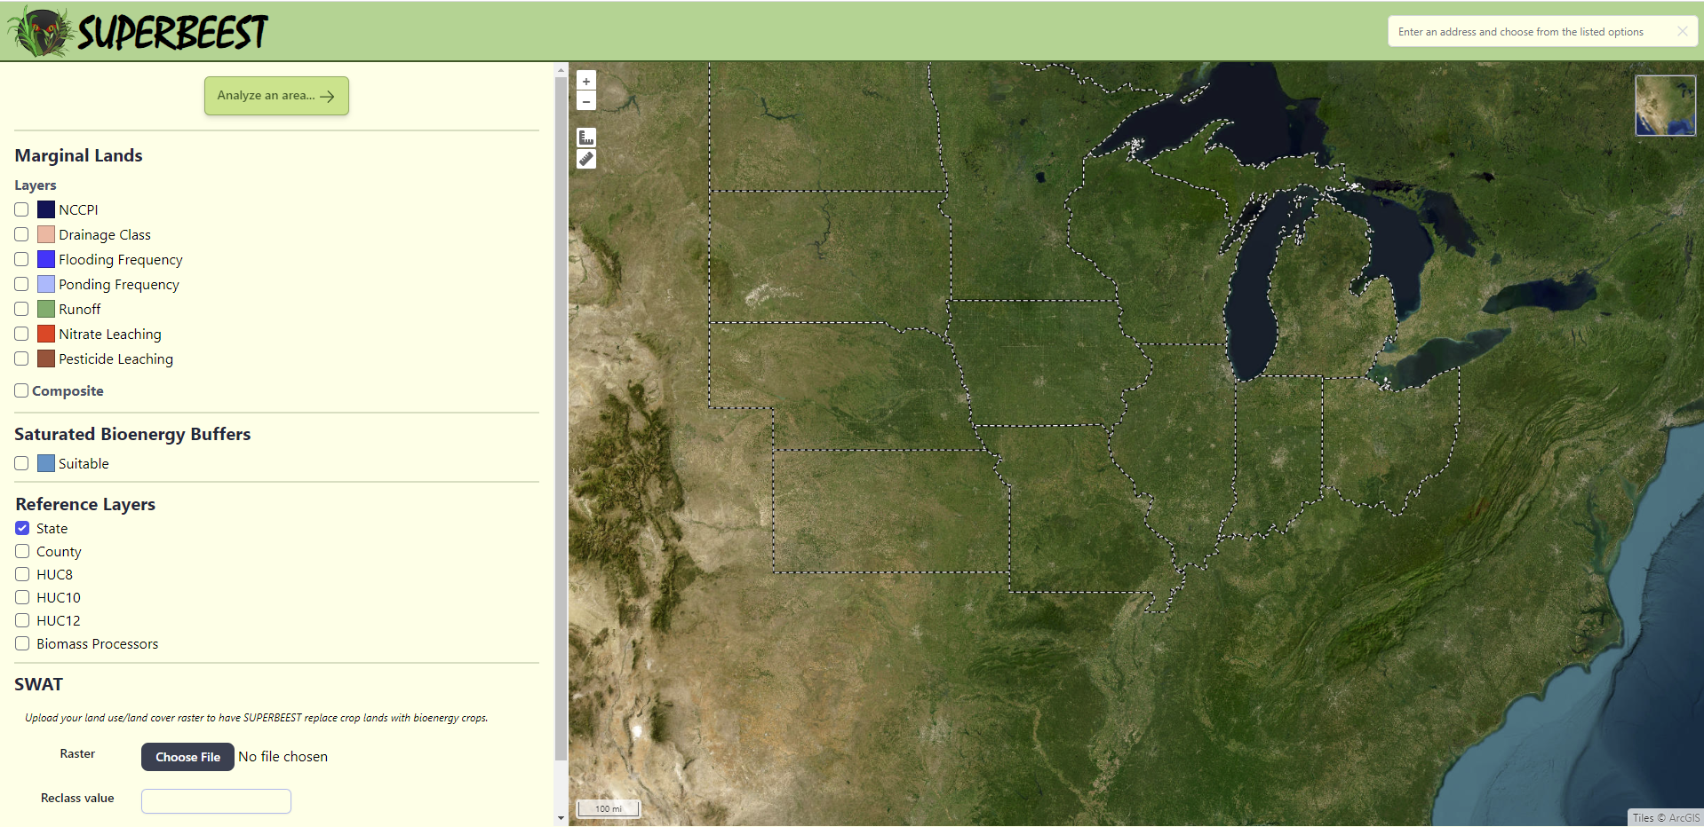
The Tutorial
Launch the tool
superbeest.evs.anl.gov/tool
Click the analyze an area icon to select your area of interest
Home Page
Search for a location using an address
Zoom in/out & measure areas/lengths
Check boxes to view marginalities (individually); choose a composite option to see areas where marginalities overlap
Change from satellite mode to street view or terrain using the top right icon
Identifies suitable areas for saturated bioenergy buffers
Click to add different reference layers to help identify areas of interest
Hover over the map and scroll to zoom in/out

Slide 4
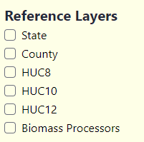
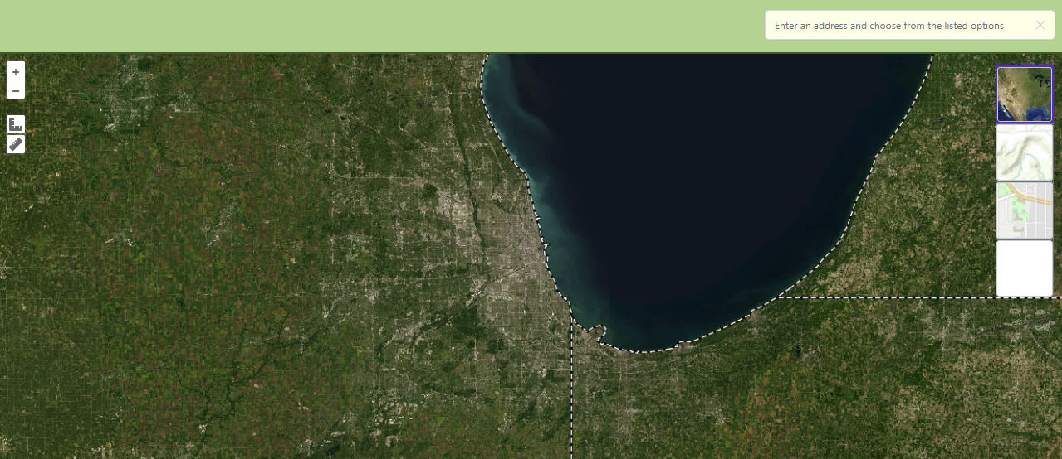
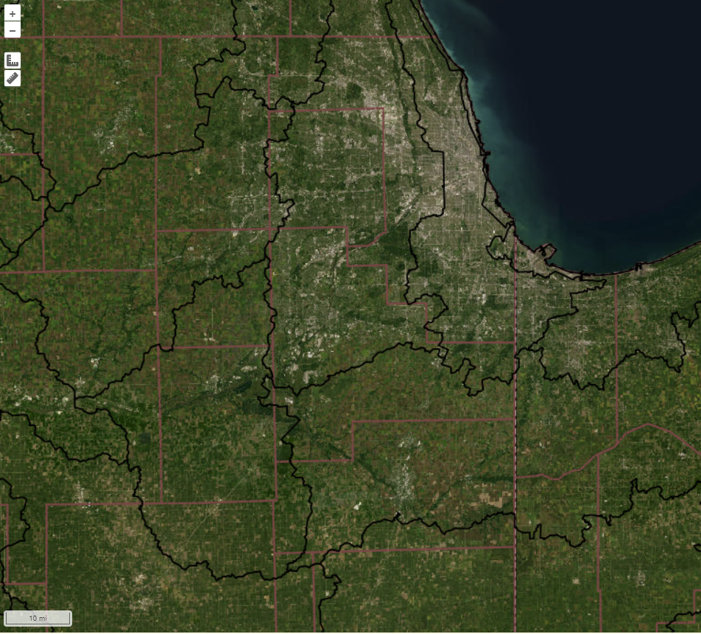

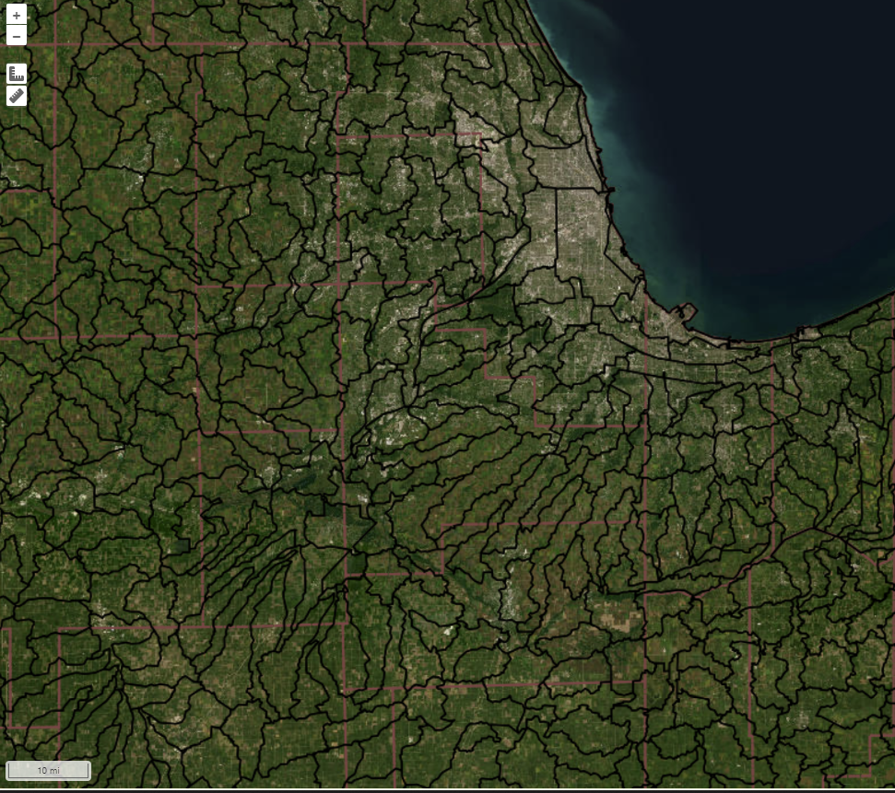
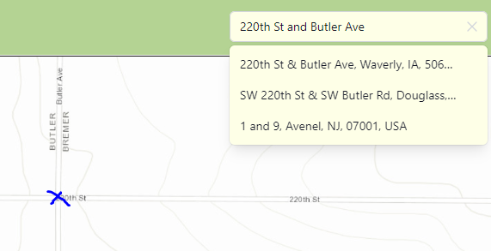
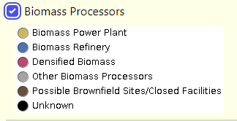
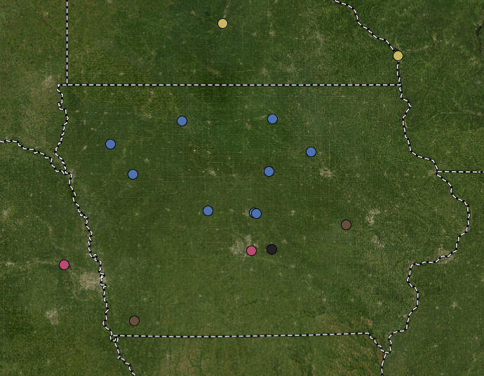
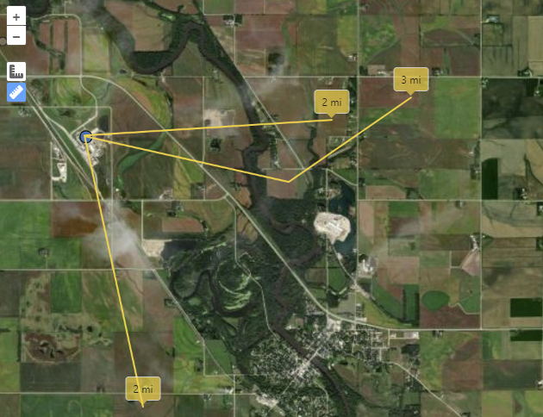
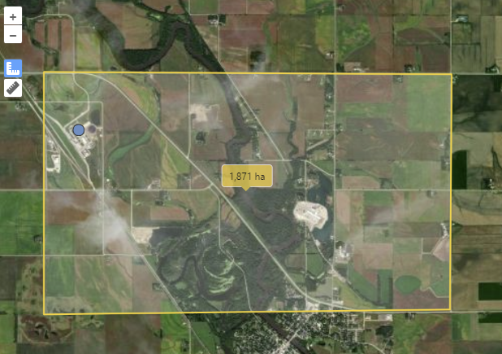

Step 1: Find Your Area of Interest
Map functions
Search for a location using an address
Adding Reference Layers
One or more reference layers can be added to the map
Examples below show counties and watersheds
Zoom in/out & measure areas/lengths
Hover to change from satellite mode to street view or terrain using the top right icon
Hover over the map and scroll to zoom in/out
HUC8
HUC10
HUC12
Address Toolbar:
Type in a specific address, street corner, town or county and select an option from the dropdown menu
HUC = Hydrologic Unit Codes
Biomass Processors
Power plants – burn biomass for electricity or heat
Refineries – generate fuels
Densified biomass – pellet plants
Other – R&D and other bioproducts (biochar, erosion socks, pulp, etc.)
Closed facilities – maintained in the database as possible “brownfield” sites, facilities that may be repurposed again as future biomass processor sites
Measure Tools : used to measure distances and areas
Click on tool to start measuring
Click tool to turn off
Single click to create a vertex
Double click to finish a line or polygon
Measure Distance
Measure Area

Slide 5
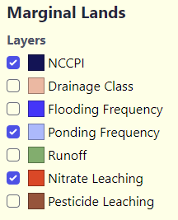
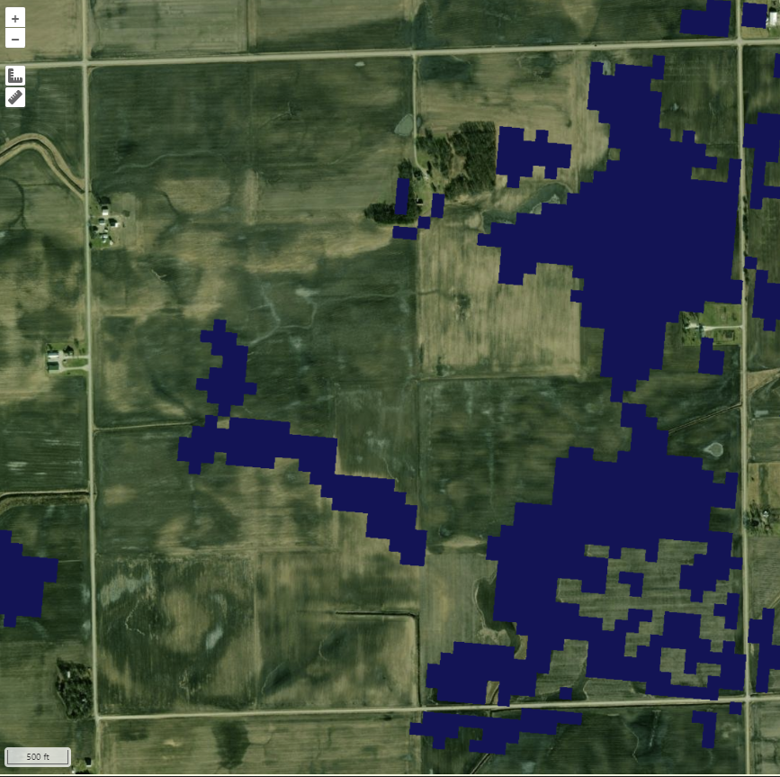
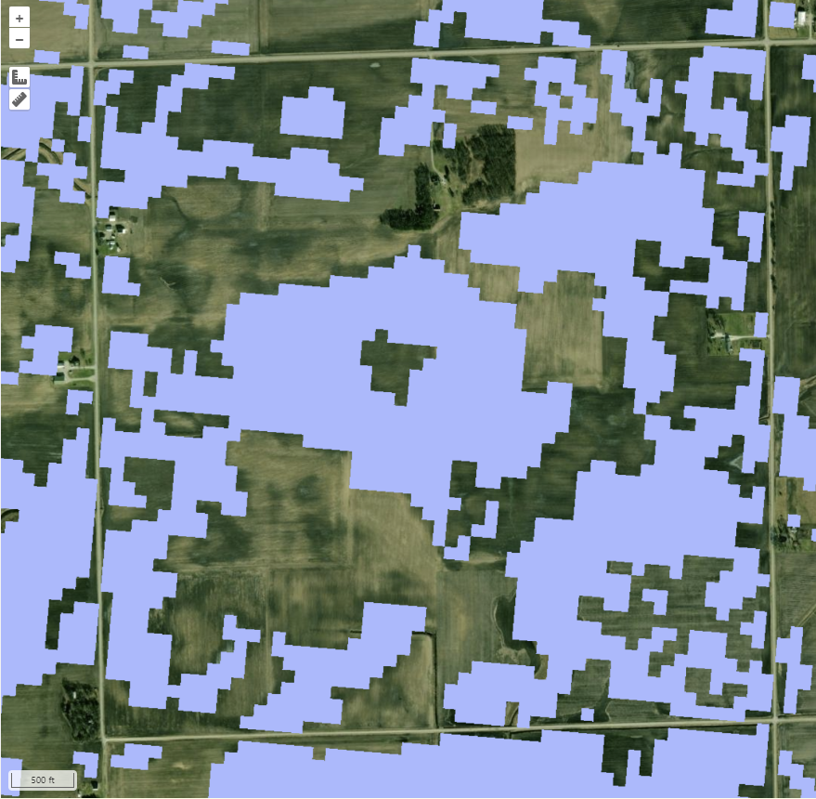
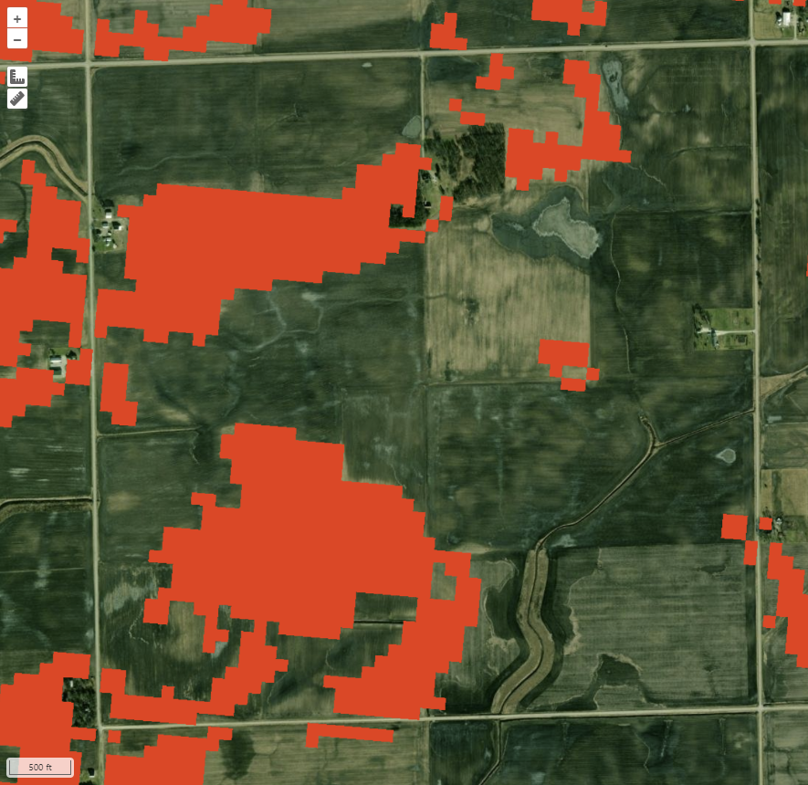
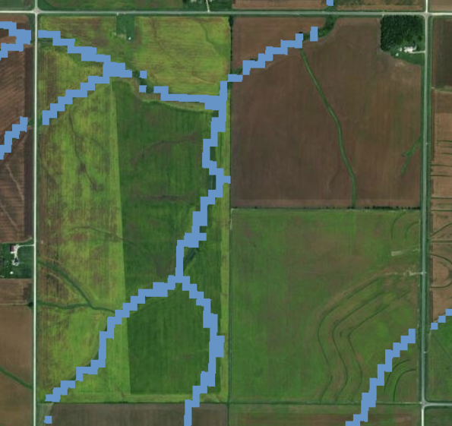

Step 2: Identify Marginal Land & Areas Suitable for Saturated Bioenergy Buffers
Economic and environmental land marginalities can be displayed for the row crop and pasture lands in your area of interest by checking the boxes. One or multiple marginalities can be displayed at a time.
NCCPI : national commodity crop productivity index (economics) - average and fair classified as marginal
Drainage Class: SSURGO drainage classes - somewhat poor, poorly drained, and very poorly drained classified as marginal
Flooding Frequency : SSURGO Flooding frequency classes - occasional common, frequent, and very frequent classified as marginal
Ponding Frequency : SSURGO ponding frequency classes - occasional, common, and frequent classified as marginal
Runoff : SSURGO surface runoff classes - high and very high classified as marginal
Nitrate Leaching : USGS data – classified as marginal if a significantly thick surficial aquifer or carbonate (karst) bedrock is close to the surface
SSURGO = Soil Survey Geographic Database
(USDA-NRCS)
Pesticide Leaching : a subset of the nitrate leaching layer where SSURGO data also indicates 3% organic matter content in the soil
Check the Saturated Bioenergy Buffers to identify suitable areas to place saturated bioenergy buffers in tile-drained agricultural lands
Saturated Bioenergy Buffers: For tile-drained land. Suitability is limited to placement along ditch or stream channels. Based on soil drainage, topography, soil organic matter content, soil erodibility factor, and hydraulically restricting layers

Slide 6

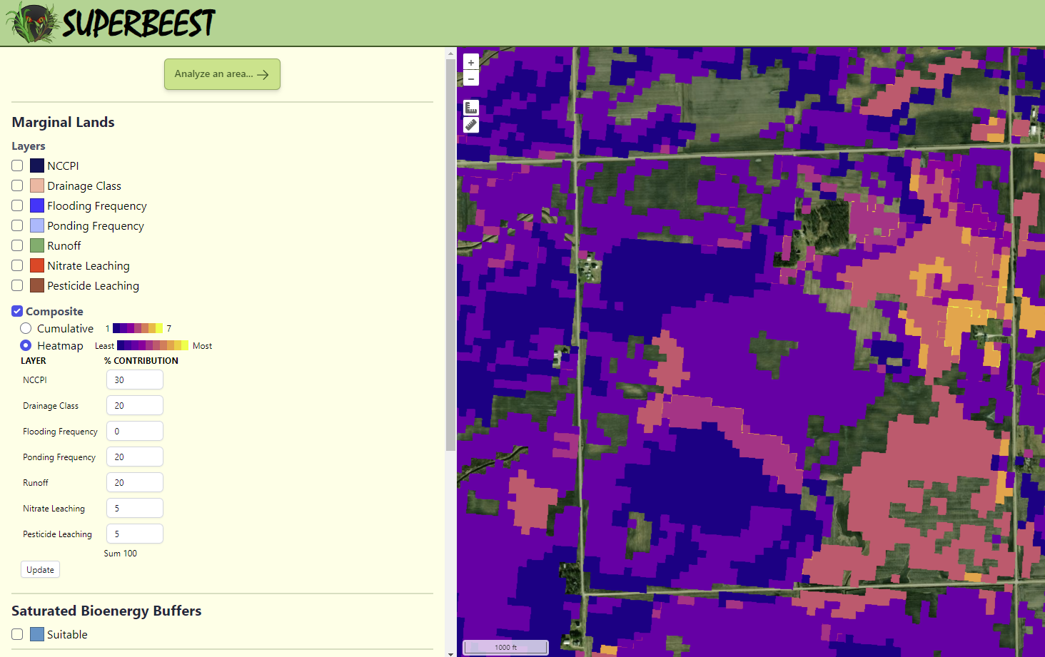
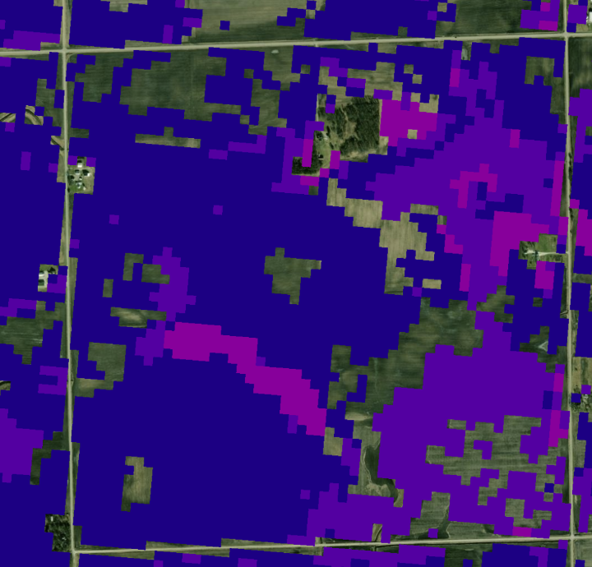

Step 2: Identify Marginal Land & Areas Suitable for Saturated Bioenergy Buffers
Use Composite to identify areas where multiple marginalities overlap. These areas might be the most problematic for production of traditional row crops or pasture and may be preferred areas to covert to perennial bioenergy crops.
There are two options that can be used to display this information
These composite layers are based upon the 7 marginalities only, excluding saturated bioenergy buffer layers
Heatmap:
Allows users to weigh the marginalities based on their goals and preferences
Cumulative:
Shows areas where the marginalities overlap with color coding based upon the number of marginalities present from 1 to 7
Add % contributions to each marginality from 1 to 100 %, then hit Update to generate the map
The higher the percent, the higher that marginality will be weighted
In this example we weighted NCCPI the highest at 30%, followed by drainage, ponding, and runoff at 20% each, with less interest in nitrate and pesticide leaching (5%). The lighter areas fit the preferences best and are optimal for conversion to perennial bioenergy crops
Lighter colored areas (circled) show where multiple marginalities are present and are optimal for conversion to perennial bioenergy crops to achieve multiple environmental benefits
*When adding %, the total for all 7 marginalities needs to add up to 100%. A total sum is shown for all categories and a warning is given when the total is not 100%

Slide 7
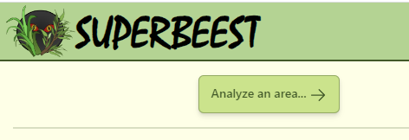
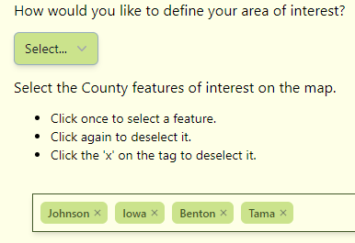
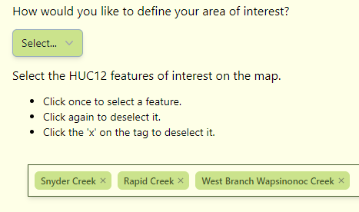
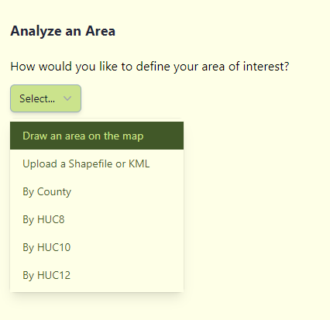
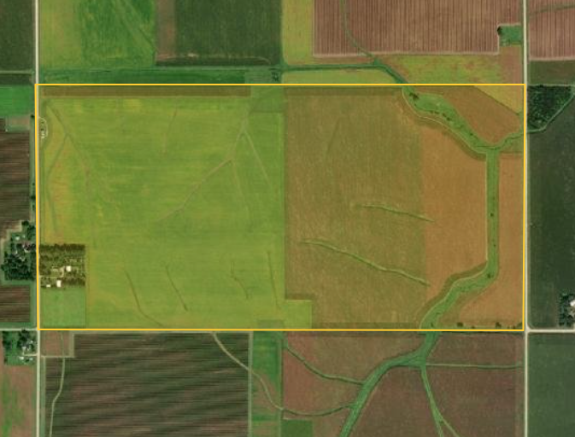
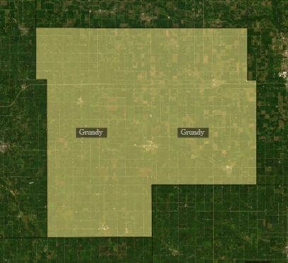
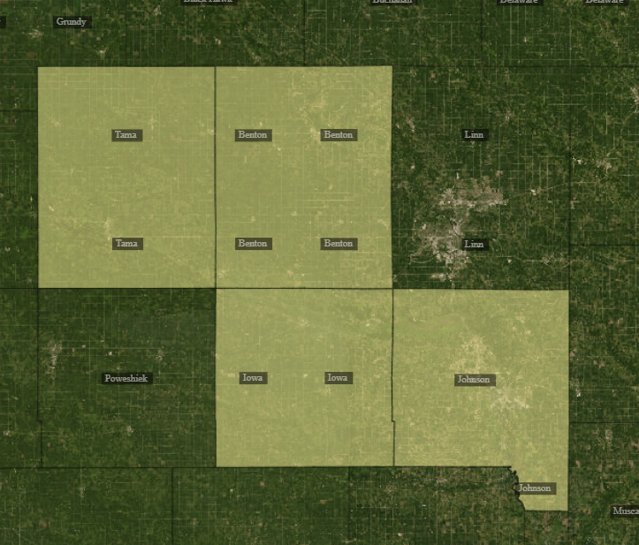
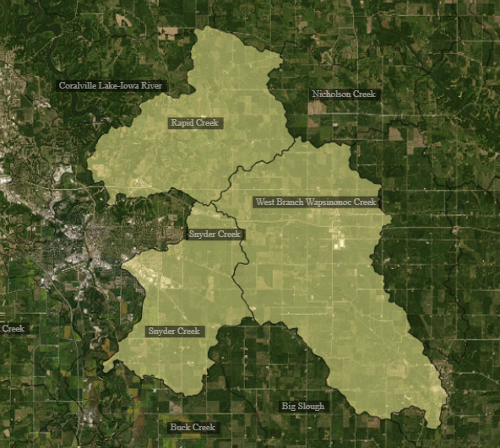
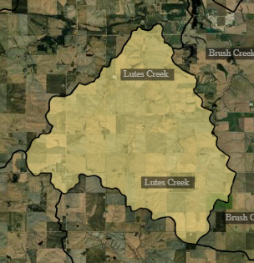
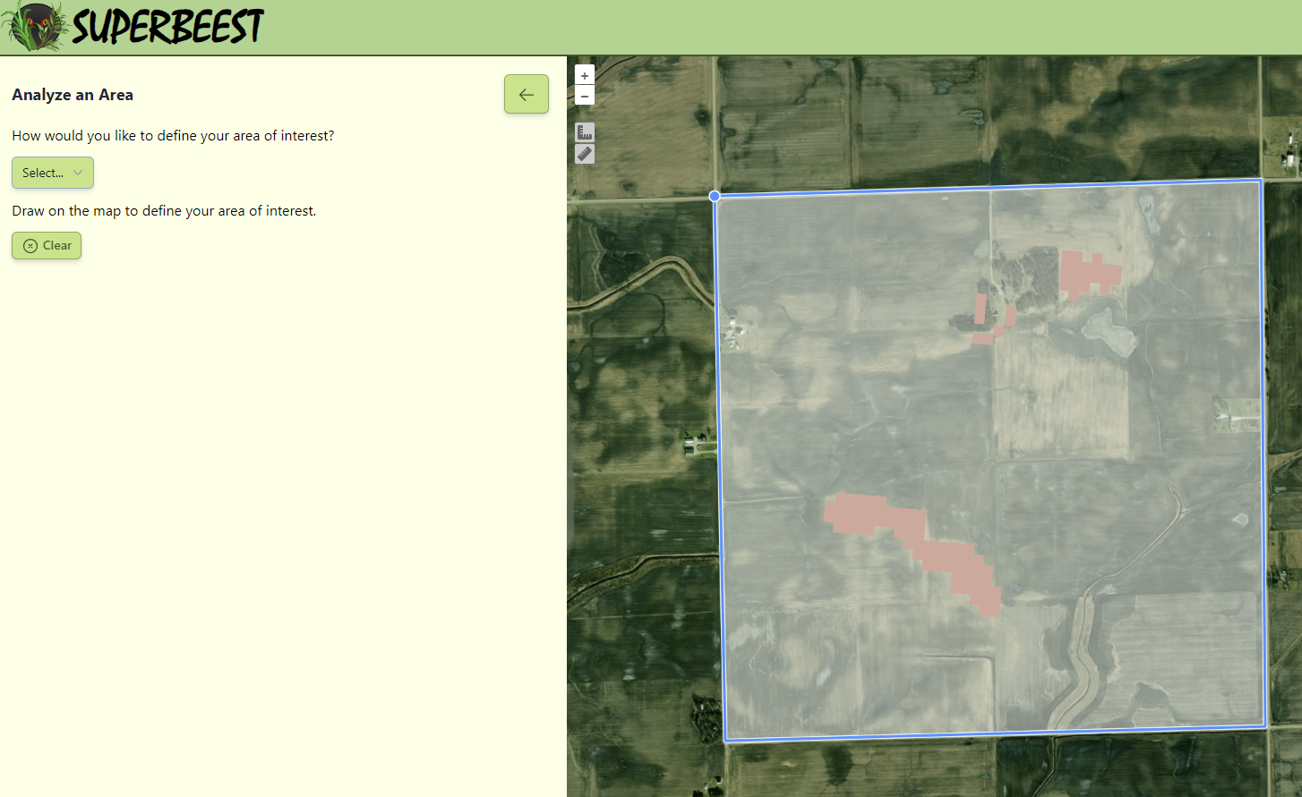
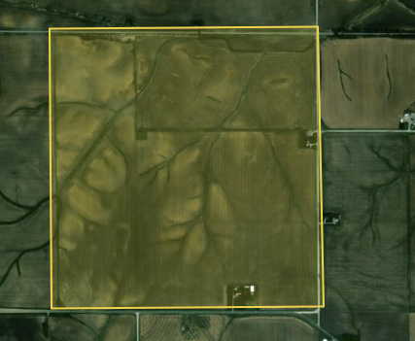
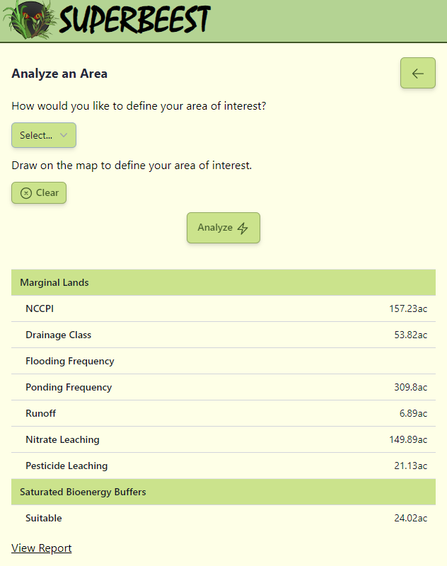
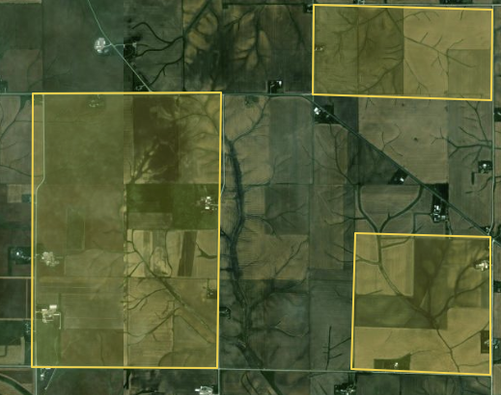


Step 3: Analyze your Area of Interest
When you are ready to analyze your area of interest (AOI) and generate output
2b
When you choose to select by county or HUC (watershed)
1
The map will show counties or HUCs (you’ll see the labels appear) – click on the ones you want to select
Select how you want to define your AOI
Field
2
You can choose to draw your own boundary on the map as shown in the figure on the top right, or select one or more counties or watersheds (HUC 8,10, or 12 levels)
County
Hit the “x” to remove selected features
HUC 12
2a
Draw your own AOI
Counties
HUC 12 watersheds
3
Hit analyze once you’ve selected your AOI
When you select draw an area on the map, a blue cursor will appear when you hover over the map
Single click to create a starting point and vertex
Double click to finish the polygon
Can draw one or more AOI
A summary of the total acreage per marginality is reported along with the amount of suitable acres for saturated bioenergy buffers.
Hit clear to start over
Click to generate a printable report

Slide 8
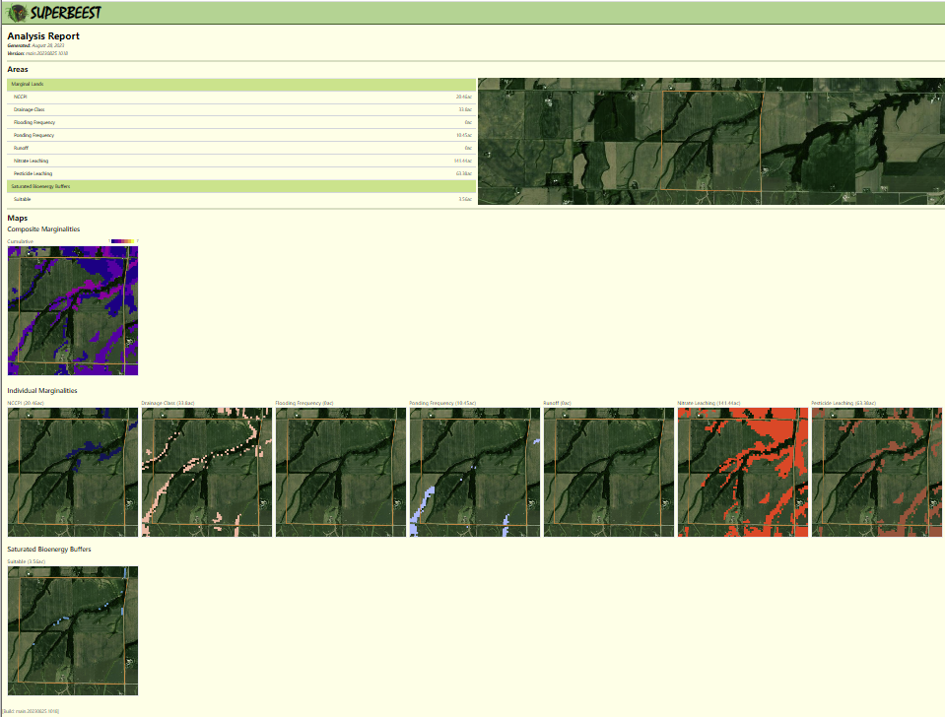
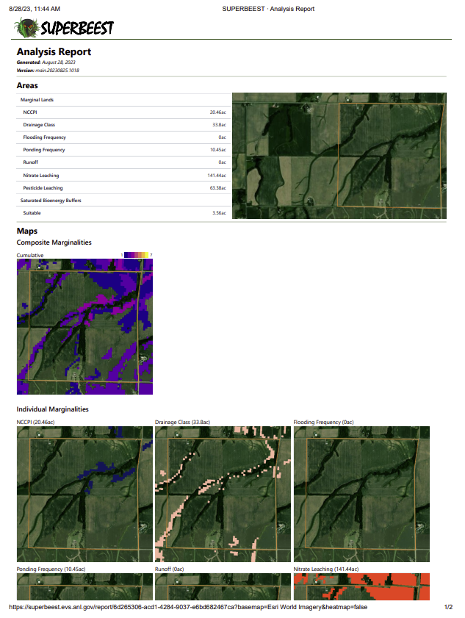
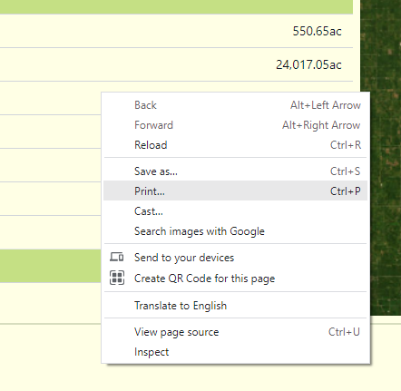
Step 4: Printable Report
When you select “View Report” a new window will open which will generate a report with the same marginal lands table presented previously as well as maps of the AOI, marginalities, and suitable areas for saturated bioenergy buffers.
SUPERBEEST version used is listed
Composite map
Maps of individual marginalities and saturated bioenergy buffers and their corresponding acreage
To print the report –
Either right click anywhere on the screen to open up the window shown (right) and choose print
Or press Ctrl+P

Slide 9
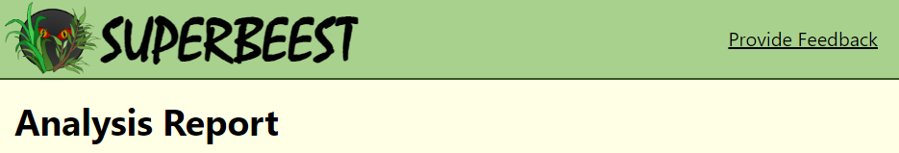
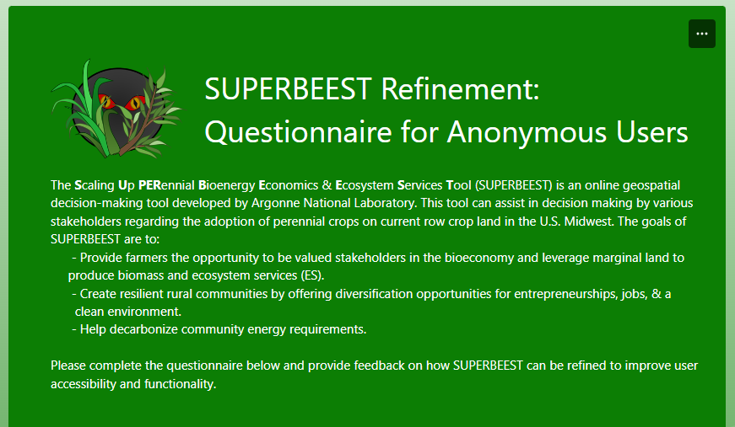
Feedback
We’d love to hear about your experience using the tool
Thank you for taking the time to use SUPERBEEST!
We are always continuing to update this tool’s capabilities and refine the user’s experience.
If there are any changes or suggestions that you’d like to see to improve the tool’s value to you or improve its ease of use, please use the link at the top of the analysis report page to provide feedback.

Slide 10

Contact Us
Need Assistance with SUPERBEEST or interested in a specific analysis for your area of interest?
Contact us at: bioenergy@anl.gov or Brad Kasberg at bkasberg@anl.gov
Want to learn more about our research on bioenergy crops and ecosystem services?
Visit our website : web.evs.anl.gov/bioenergy
acknowledgements
The research was supported by the U.S. Department of Energy (DOE), Office of Energy Efficiency and Renewable Energy (EERE), Bioenergy Technologies Office (BETO), under Award No. DE-EE0022598. Argonne National Laboratory is managed by UChicago Argonne, LLC, for the U.S. DOE under contract DE‐AC02‐06CH11357.

Slide 11

More Info - Defining Marginalities
The following datasets were used to define the marginalities used in SUPERBEEST
NCCPI & SSURGO Classifications
    National Commodity Crop Productivity Index (NCCPI)
    Soil Survey Geographic Database (SSURGO)
      Soil drainage
      Frequency of water ponding
      Frequency of flooding
      Surface runoff
0 = not marginal
1 = marginal
For more information: Ssegane, H. and M.C. Negri, 2016, An Integrated Landscape Designed for Commodity and Bioenergy Crops in a Tile-Drained Agricultural Watershed. Journal of Environmental Quality, 45:1588–1596, DOI:10.2134/jeq2015.10.0518.

Slide 12

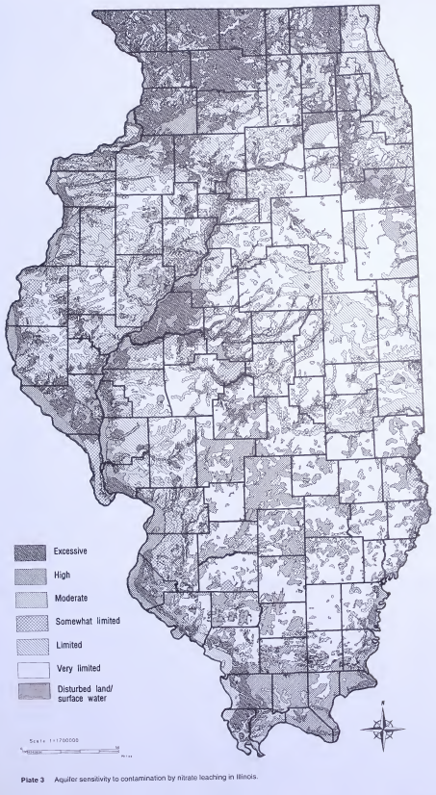
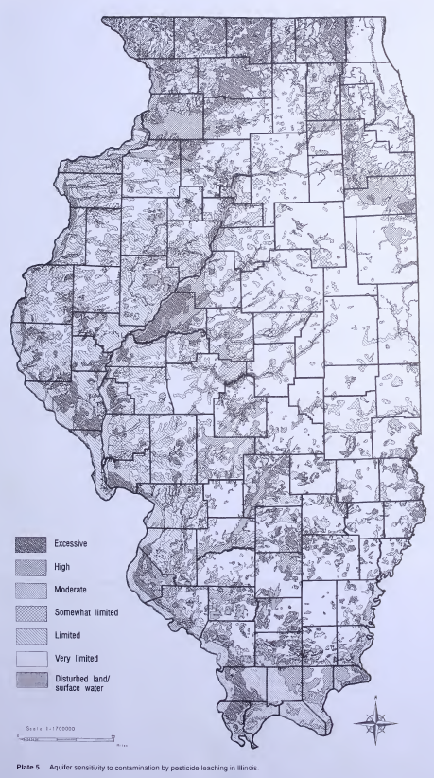
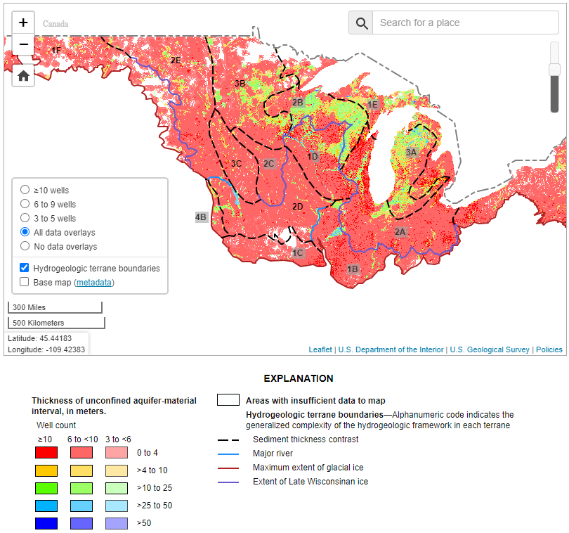
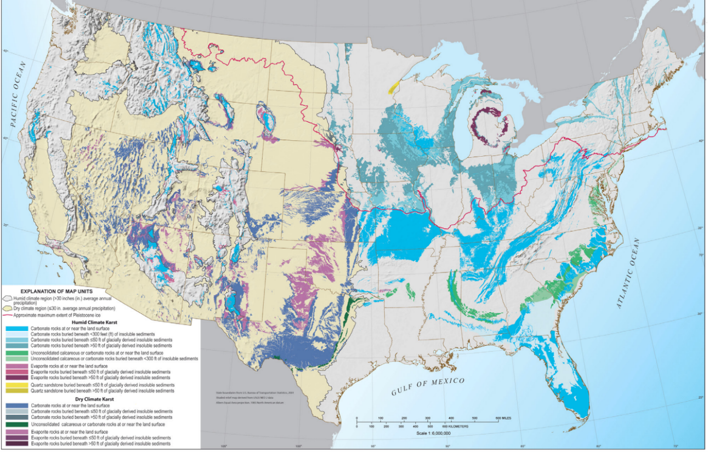
More Info - Defining Marginalities
The following datasets were used to define the nitrate and pesticide leaching marginalities in SUPERBEEST
    U.S. Geological Survey products: to assess potential for nitrate and pesticide leaching
Leaching in Illinois
Leaching in the U.S. Midwest
Past work in Illinois was based on the Keefer (1995) method
Similar approach to map the U.S. Midwest based on available USGS information
Data Source | Marginal Classification
USGS mapping of the thickness of surficial sandy aquifers in the Midwest | Areas with a suitably thick (>4 m) surficial sandy aquifer (for pesticide, soil organic matter < 3%)
USGS mapping of karst – susceptible areas with carbonate rocks near the land surface | Areas with carbonate rock at or near the surface (for pesticide, soil organic matter < 3%)
0 = not marginal; 1 = marginal
Nitrate
Pesticide
Thickness
Carbonate Rock
For more information: Ssegane, H. and M.C. Negri, 2016, An Integrated Landscape Designed for Commodity and Bioenergy Crops in a Tile-Drained Agricultural Watershed. Journal of Environmental Quality, 45:1588–1596, DOI:10.2134/jeq2015.10.0518.
source: modified from Yager et al. 2020
source: Weary and Doctor 2014

Slide 13

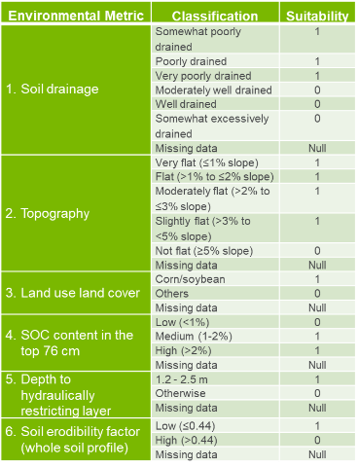
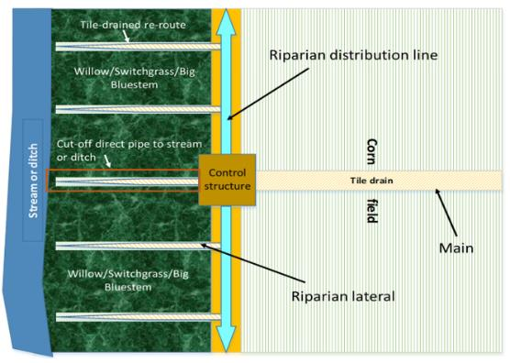
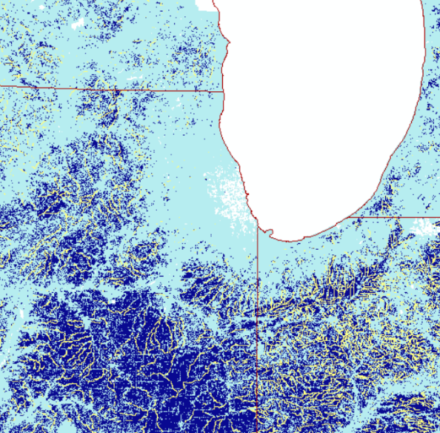
More Info – Defining Saturated Bioenergy Buffers
Saturated Bioenergy Buffers (SBBs) can capture nutrient-rich, drainage water from a tile-drained system via a control structure and utilize it for growing bioenergy crops to:
Improve farm economics
Protect the environment from nutrient loss
SBB Site Suitability Classification
Lake Michigan
Site Suitability
Riparian land only with width of 20-30m from the ditch or stream edge
Requires inputs on soil, topography/slope, landuse/landcover, and drainageway locations
Analysis is a GIS-based multicriteria decision analysis
0 = not suitable
1 = suitable
For more info: Cacho, J.F, J.J. Quinn, C.R. Zumpf, and M.C. Negri, 2021, Saturated Bioenergy Buffers: Site Suitability Classification and Estimated Areas of Candidate Sites in the U.S. Midwest under Three Scenarios: Argonne Technical Report ANL/EVS-21/2. https://publications.anl.gov/anlpubs/2021/05/166535.pdf

Slide 14

More Info – Biomass Processors
This table lists the major sources used for defining the locations for biomass processors.
Biomass processors were separated by type based on data sources.
Operational status of facilities listed was based on available information on the facility’s operational status such as an operating website, news articles, or other resources.
Data Sources
Name | Website | Last Modified
IEA Bioenergy Technology Collaboration Programme | https://www.ieabioenergy.com/installations/ | 2023
Renewable Fuels Association | https://ethanolrfa.org/resources/ethanol-biorefinery-locations | Not specified
US DOE Office of Energy Efficiency and Renewable Energy | https://www.energy.gov/eere/bioenergy/integrated-biorefineries | 2022
ArcGIS resource: uploaded by Krista Merry | https://www.arcgis.com/home/item.html?id=4be8ec6968d34eadb027bfec1ceb947a | 2014
US Biochar Initiative | https://biochar-us.org | 2023
EPA Risk Management Plan (RMP) – The Right-To-Know Network | various | Not specified
Biomass Magazine | https://biomassmagazine.com/plants/listplants/biomass/US/page:1/sort:feedstock/direction:desc | 2022
Association of Warm Season Grass Producers | https://www.awsgp.org/ | 2022
U.S Energy Information Administration (EIA) | https://www.eia.gov/biofuels/biomass/#dashboard | 2023
National Renewable Energy Laboratories (NREL) | https://maps.nrel.gov/?da=biofuels-atlas | 2014

